Slide 1
Learning to Anticipate
LSTM Hand-Trajectory Prediction for Latency Compensation in Vision-Based Robot Teleoperation
MediaPipe Hands + MoveIt Servo Pose Tracking on a 6-DOF Arm
Machine Learning — Final Project, NTNU · June 2026

Slide 2
Motivation: Smoothing Trades Jitter for Lag
Vision-based teleoperation: a single webcam tracks the operator’s hand; a 6-DOF arm follows in real time
The raw hand position is noisy — landmark jitter, camera noise, and a hand-size-based depth estimate
The deployed pipeline smooths with an EMA (α = 0.3): group delay ≈ 2.3 frames ≈ 75 ms at 30 Hz
Consequence: the robot is always commanded toward where the hand was, never where it is
Idea: treat lag as a forecasting problem — predict the hand ~100 ms ahead, turning lag into lead

Slide 3
System Architecture: Camera to Robot
THIS PROJECT
Webcam
30 Hz frames
MediaPipe Hands
21 landmarks on CPU
Workspace Mapping
raw 3-D target, 30 Hz
EMA → LSTM
smoothing / prediction
MoveIt Servo
P-controller + diff. IK
6-DOF Arm
ros2_control
Feedback loop closes on joint encoders — the camera only generates the reference (not visual servoing)
Position-only pose tracking: forcing a fixed orientation drives a 6-DOF wrist into joint limits
Finger gestures drive the gripper and a “ready”-pose reset; both unchanged by this project
The blue stage is replaced: an LSTM predicts the hand position ~100 ms ahead, with a runtime LSTM/EMA toggle

Slide 4
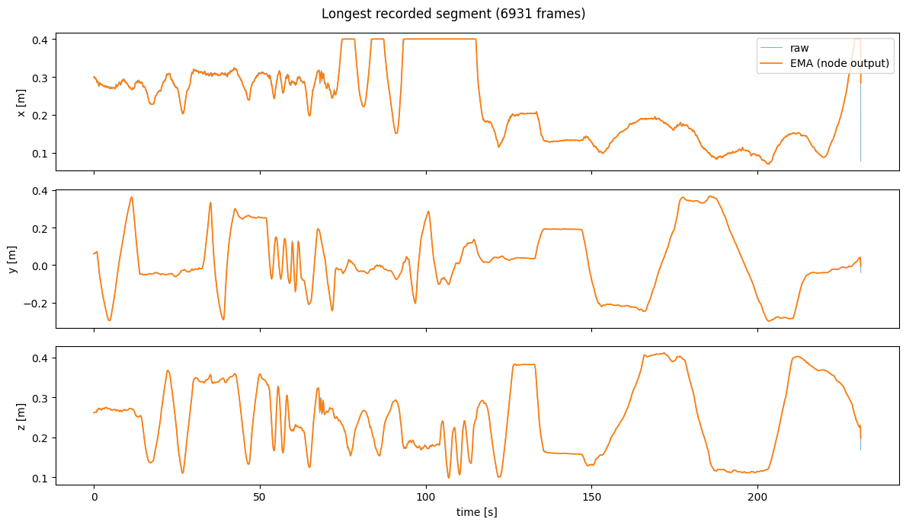
Data & Problem Formulation
Self-collected dataset: 22,420 samples over 2 sessions (≈12.3 min, 7 segments, ~30 Hz), recorded by a built-in CSV mode of the teleop node
Session 1: slow, smooth motion; session 2: deliberately mixed speeds, sweeps, holds, sharp turns
Self-supervised displacement prediction: from a window of L = 15 past positions, predict the displacement to the frame H = 3 ahead (≈98 ms)
Translation-invariant: a sweep produces identical training pairs anywhere in the workspace
Model: single-layer LSTM, 32 hidden units, ≈4.7k parameters — small enough for a 30 Hz control loop
Leakage-safe chronological 70/15/15 split per segment; no window crosses a boundary
Longest recorded segment (6,931 frames): raw signal and EMA node output, x/y/z

Slide 5
A Negative Result and Its Fix
Failure: regressing the absolute future position lost to a trivial copy-last-frame baseline by 12× (10.56 mm vs 0.84 mm)
Diagnosis — distribution shift: under the chronological split the operator had drifted to a new workspace region; absolute regression interpolates but cannot extrapolate. Shuffling the split would only have hidden this behind data leakage
Fix: predict translation-invariant displacements — the same network and training then beat both baselines (table below, session 1, H = 1)
Formulation | LSTM MAE | Persistence MAE | EMA MAE
Absolute position | 10.56 mm | 0.84 mm | 2.07 mm
Displacement (ours) | 0.58 mm | 0.84 mm | 2.07 mm

Slide 6
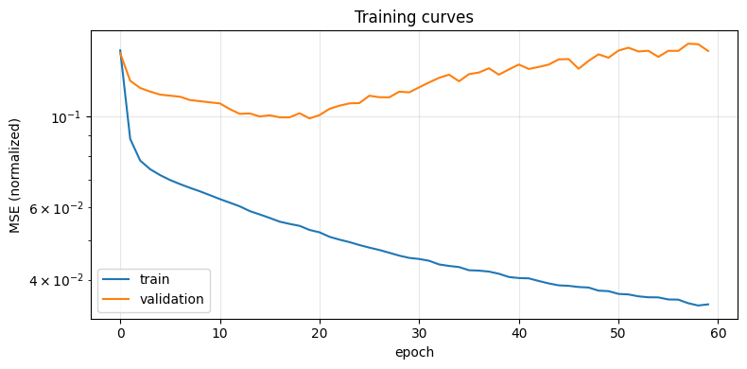
Results: 98 ms Ahead, 68% Less Error
Method | MAE [mm] | RMSE [mm]
LSTM (ours) | 2.32 | 5.68
Persistence | 4.36 | 10.27
EMA (deployed) | 7.20 | 16.75
47% better than persistence, 68% better than the deployed EMA
RMSE gap is 2.9× vs EMA — biggest wins during fast motion, where lag hurts most
5-fold blocked CV: 2.28 ± 0.45 mm MAE — beats both baselines in 5/5 folds on both metrics
Validation loss bottoms out near epoch 20; best-validation checkpointing acts as early stopping

Slide 7
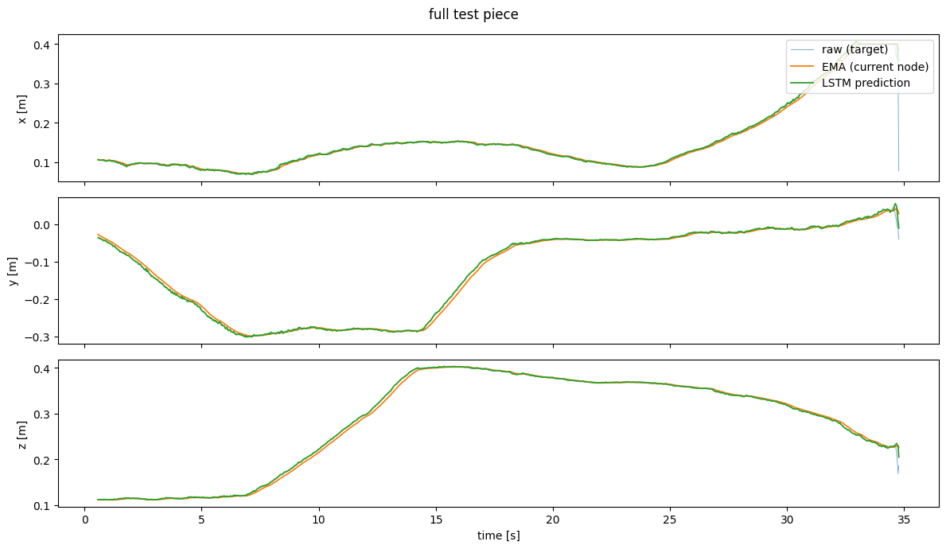
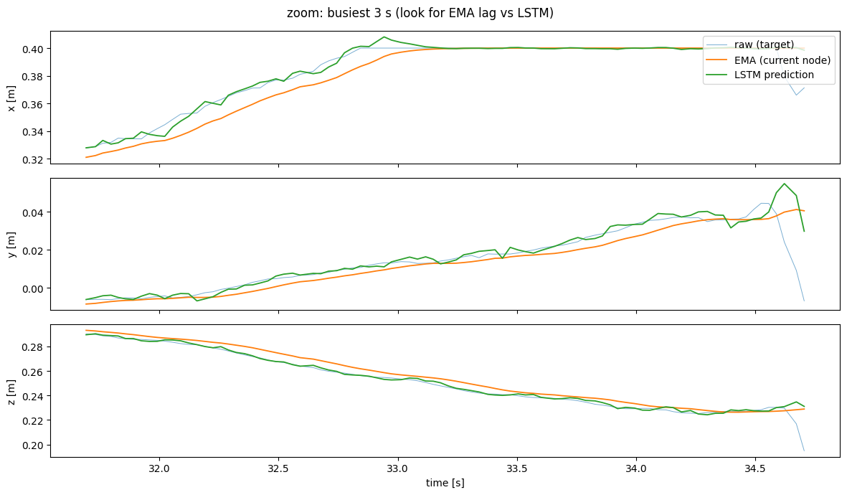
Qualitative Tracking: EMA Lags, LSTM Leads
Full test piece: raw target, EMA, and LSTM prediction overlap at this scale — no gross errors anywhere
Busiest 3 s: the EMA (orange) visibly trails the raw trajectory; the LSTM (green) tracks and slightly leads it

Slide 8
Deployment & Honest Conclusion
On the robot
TorchScript model runs inside the live ROS 2 node: 0.1–0.2 ms per inference vs the 33 ms frame budget
Ring buffer of L = 15 raw positions; EMA fallback while filling or after tracking loss; predictions clamped to the workspace safety box
Runtime LSTM/EMA keyboard toggle for live A/B comparison
Replay verification: the deployed code path reproduces the offline evaluation to within 0.01 mm
What it means
Switching LSTM/EMA on the real robot feels the same: the system is actuator-limited, not perception-limited — controller and joint limits dominate the latency chain
The 68% reduction in target error is real; exploiting it needs higher control bandwidth (faster arm, stiffer controller)
Future work: constant-velocity Kalman baseline, multi-user data, quantitative end-to-end tracking-error comparison

